Slide 1



Customer Transaction Report

Slide 2
Members of the group
Siddhant Ghorpade
Mohammad Saif
Amit Kumawat
Ratna Kumari
Date : 08/08/2022

Slide 3
Introduction:
Create a web page containing Customer Transaction Report. Where the set of transaction are stored. Where we allow merchant to add, delete or remove filters to view the set of transactions as per requirement.
If merchant doesn’t want to apply the filters then it will redirect to set of transactions page from where he can access different reports based on the given of set transactions.
Merchant can logout when ever he want.

Slide 4
Approach:
We started with database where we created 5 tables Transaction, TrasactionCart, Product, Merchant, MerchantPreferences to store the details.
Then we worked on API implementing with repositories.
Then we designed Mock UI and Implemented that in Angular.
We designed the pages as per our Idea and implemented custom transaction reports.

Slide 5
Technologies Used:
Spring Boot
Angular
MySQL

Slide 6
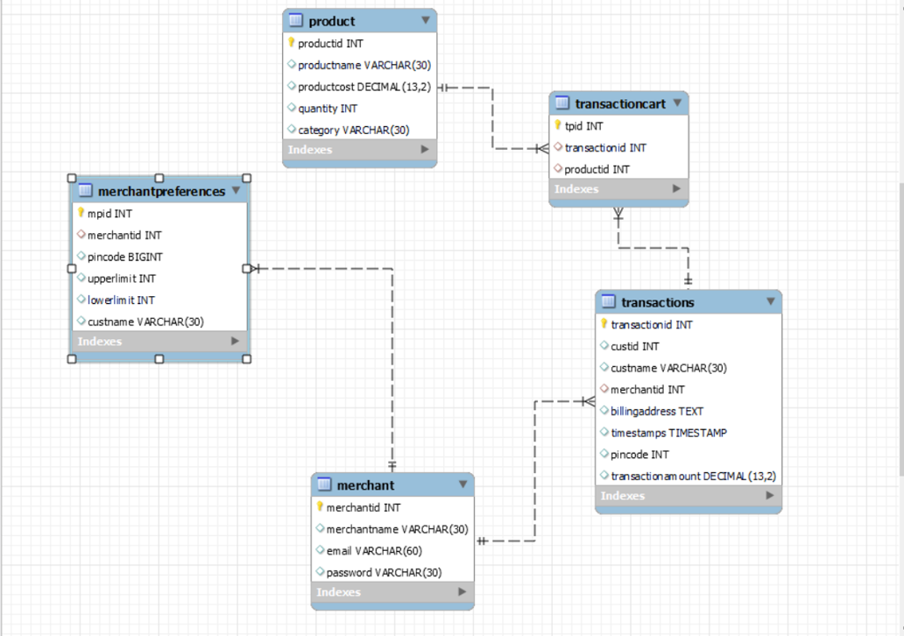
ER Diagram:

Slide 7
REST APIs:
Product API: http://localhost:8080/api/product
Merchant Preferences API: http://localhost:8080/api/merchantPreferences
Merchant Preferences Upper-limit API: http://localhost:8080/api/merchantPreferences/search/findByUpperLimit{?upperLimit}
Merchant Preferences Lower-limit API: http://localhost:8080/api/merchantPreferences/search/findByLowerLimit{?lowerLimit}

Slide 8
Merchant Preferences Customer-Name API: http://localhost:8080/api/merchantPreferences/search/findByCustName{?custName}
Merchant Preferences Pincode API: http://localhost:8080/api/merchantPreferences/search/findByPincode{?pincode}
Transaction: http://localhost:8080/api/transactions
Transaction Cart: http://localhost:8080/api/transactioncart
Merchant Login Credentials API: http://localhost:8080/api/loginCredentials

Slide 9
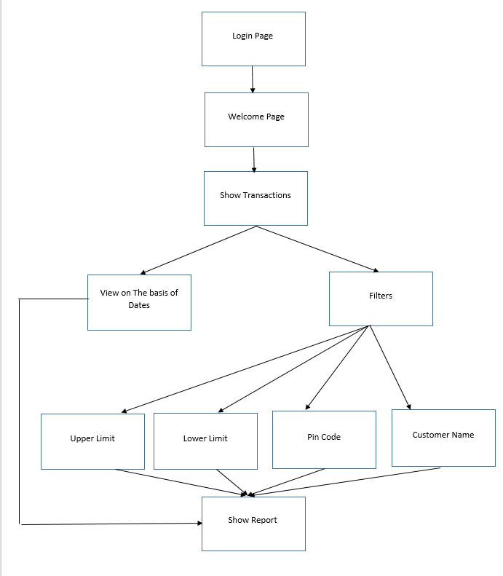
Flow Diagram:

Slide 10
Challenges:
Understanding the flow of project.
Writing methods for working of different filters and prioritize filters.
To design our backend part for ease of operations on front end.
Writing logic for filters based on filter preferences.

Slide 11
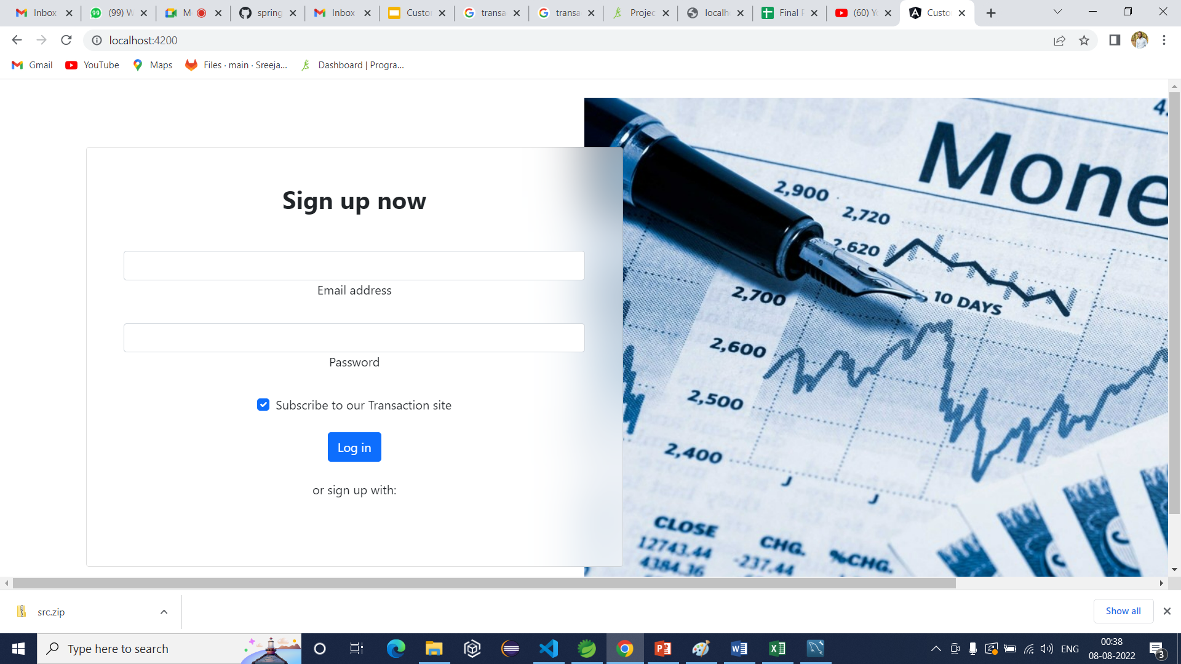
Screenshots:

Slide 12
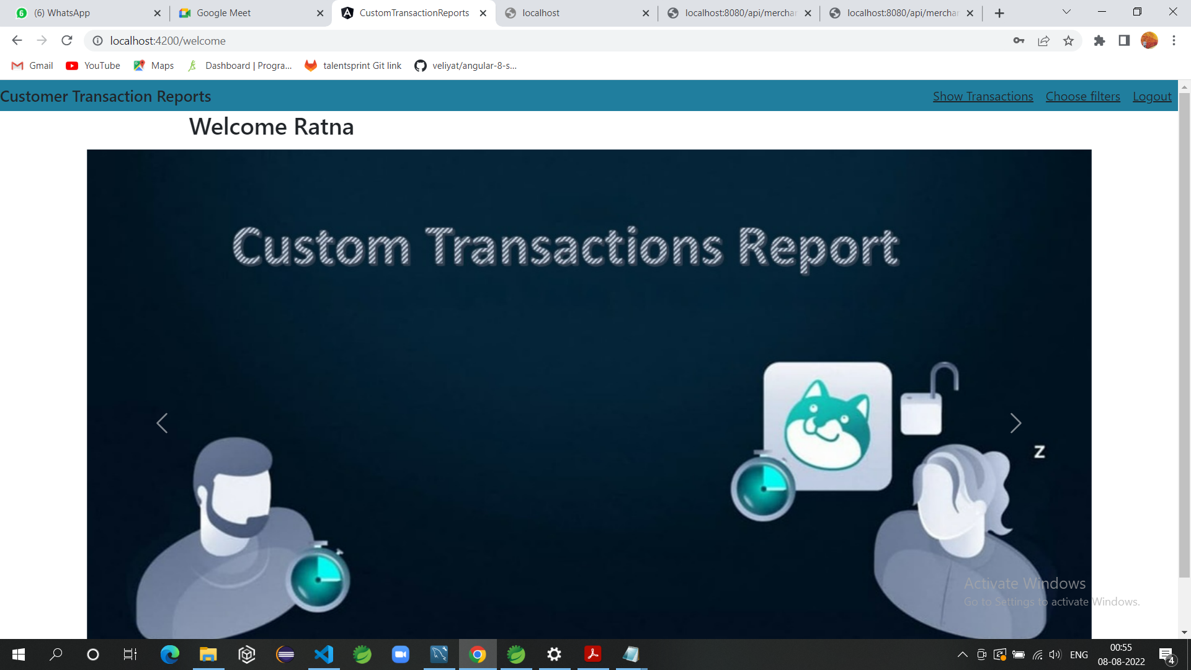

Slide 13
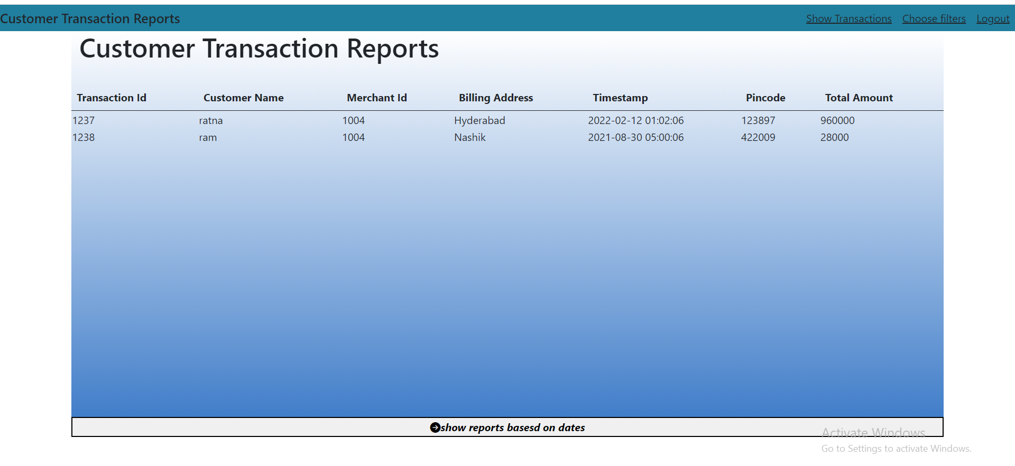

Slide 14
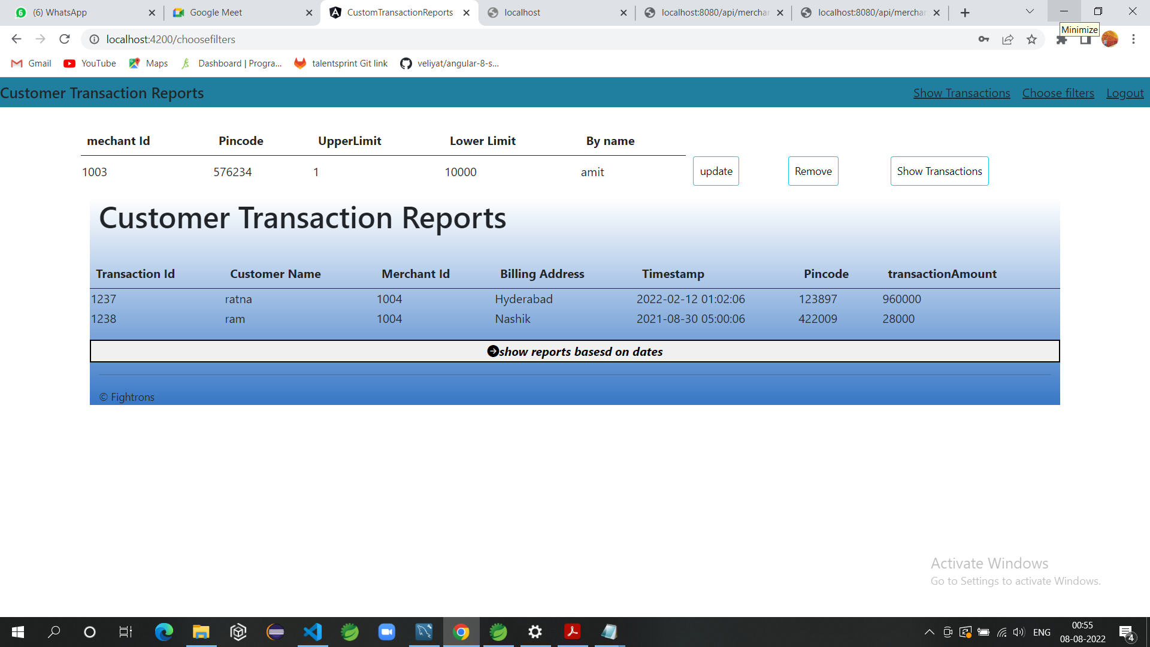

Slide 15
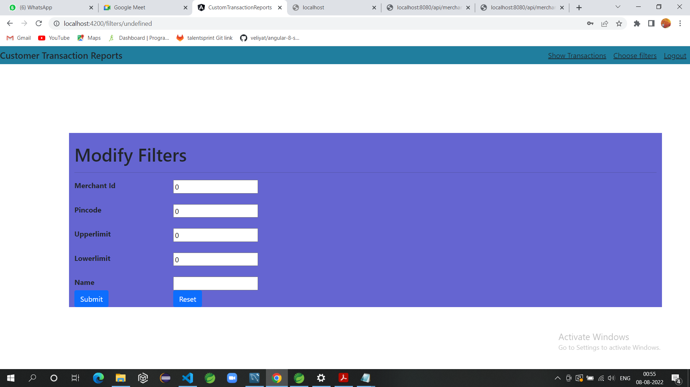

Slide 16
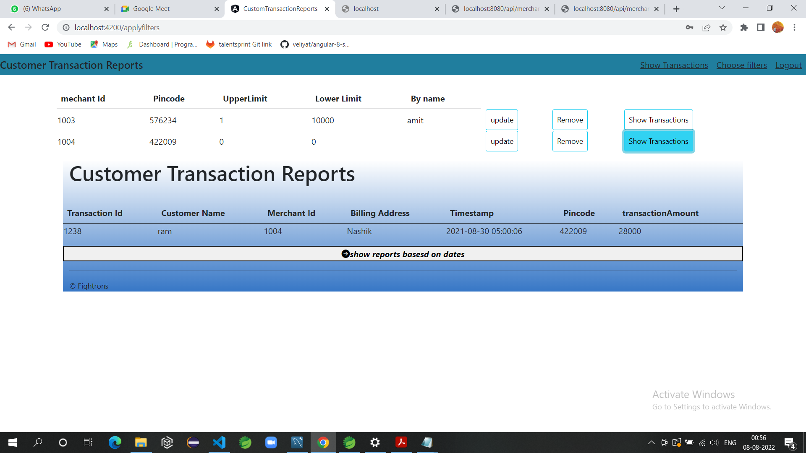

Slide 17
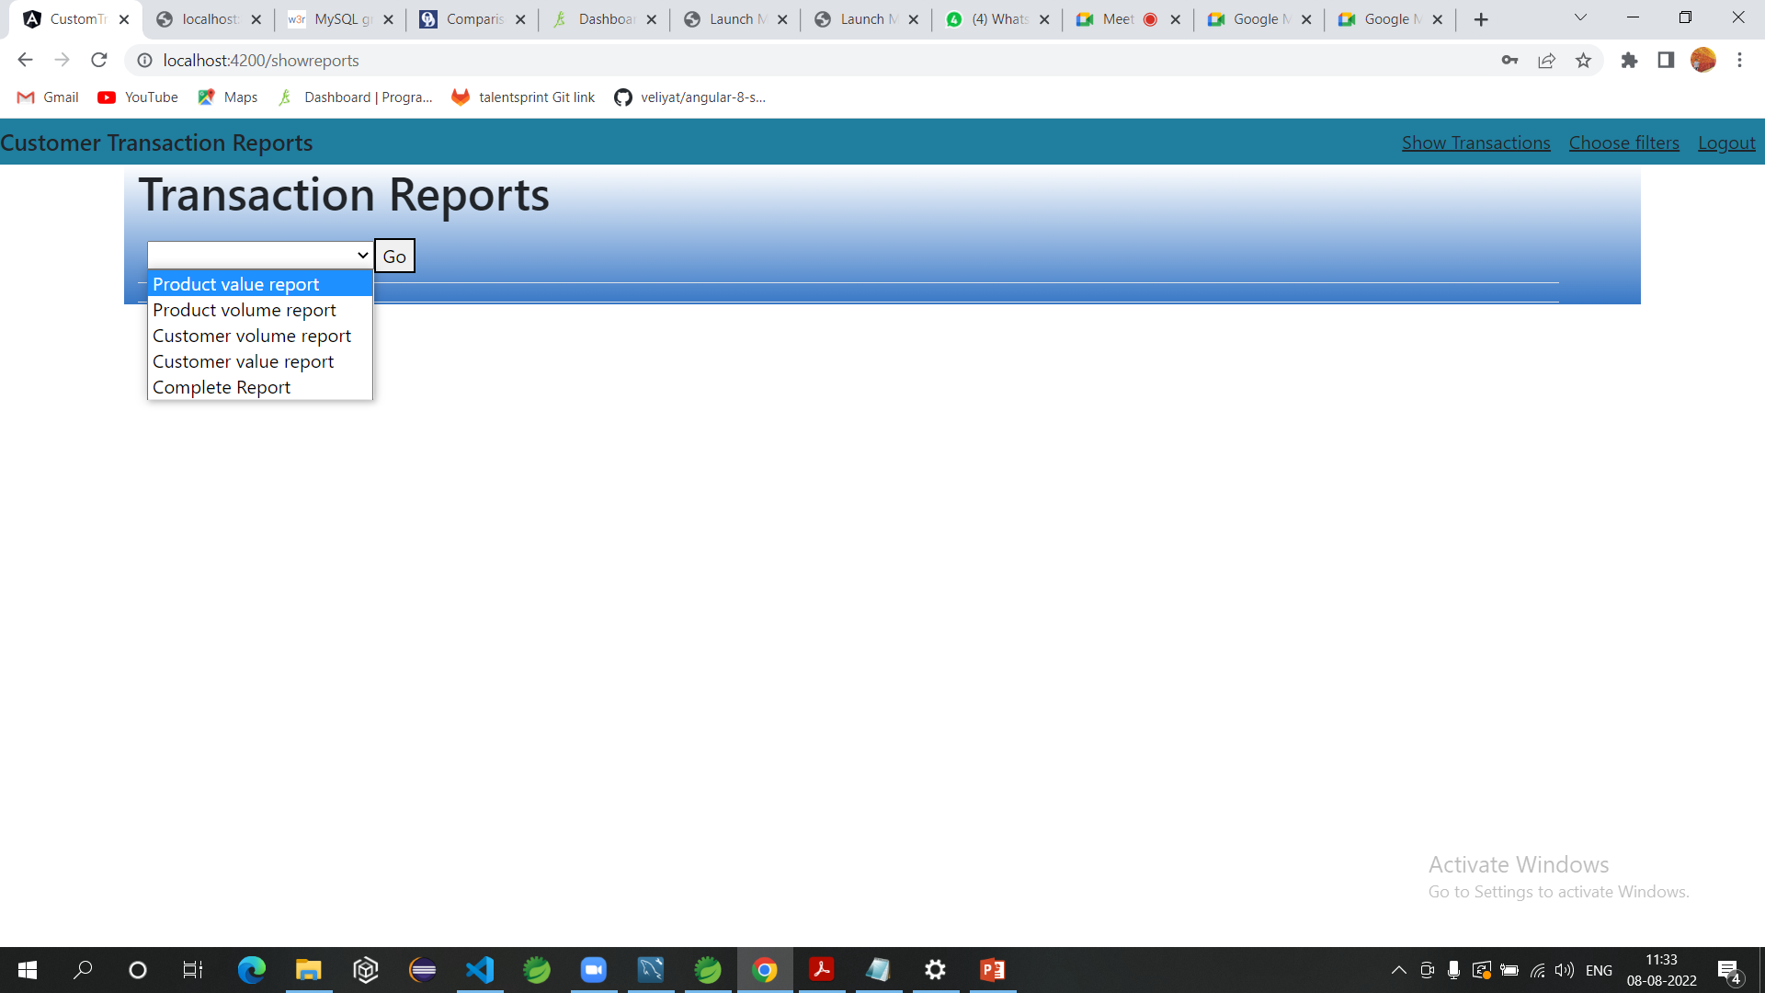

Slide 18
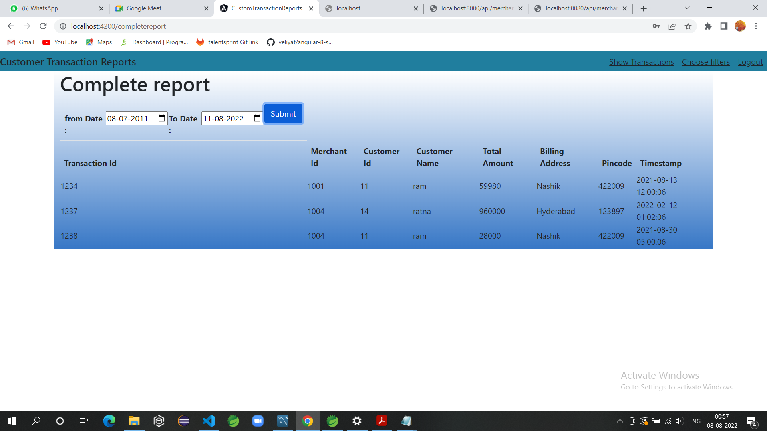

Slide 19


